Slide 1
Teachers’ Initial Responses to High-Leverage Instances of Student Mathematical Thinking
BuildingOnMOSTs.org
Shari L. Stockero – Michigan Technological Univ.
Laura R. Van Zoest – Western Michigan University
Mary A. Ochieng – Strathmore University
Joshua M. Ruk – Western Michigan University
Blake E. Peterson – Brigham Young University
Keith R. Leatham – Brigham Young University
Supported by
Leveraging MOSTs: Developing a Theory of Productive Use of Student Mathematical Thinking
a 5-year collaborative research project funded by the US National Science Foundation (DRL-1220141, DRL-1220357, DRL-1220148)

Slide 2
Teacher Responses to Student
Mathematical Thinking (SMT)
Teacher responses affect student learning and support very different types of instruction
(Kazemi & Stipek, 2001; Ing et al., 2015)
Our prior work found that teachers’ hypothetical responses to high-leverage instances of SMT:
  Were often directed to the student who contributed the SMT
  Aimed to develop or justify the student contribution
  Incorporated the students’ words and idea
  (Stockero, Van Zoest, Peterson, Leatham, & Rougée, 2017)
Notes:
Reponses affect student learning
Those that press students to engage in further thinking provide increased learning opportunities (Kazemi & Stipek, 2001)
Those that encourage students to engage with each others’ thinking correlate with increased participation and higher achievement (Ing et al., 2015)

Slide 3
Research Foci
Understand characteristics of teachers’ initial in-the-moment responses to
high-leverage instances of SMT that surfaced during their whole-class instruction
Compare teachers’ responses during instruction to teachers’ hypothetical responses during a scenario interview
Notes:
Use these characteristics to discuss the productivity of various teacher responses

Slide 4
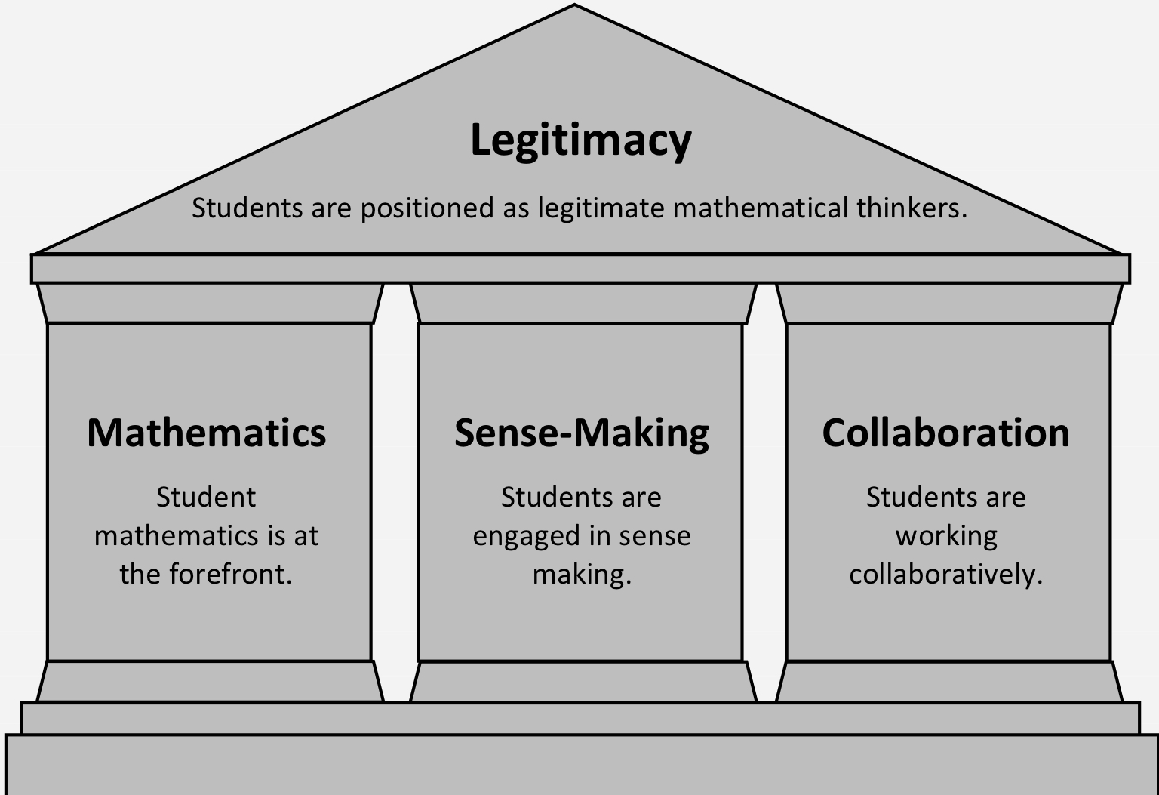
Principles Underlying Productive Use of SMT
Drawn from NCTM’s Principles to Action, 2014
Notes:
Measure of productivity of teacher responses.

Slide 5
High-leverage Instances of SMT
MOST Analytic Framework (Leatham et al., 2015)
Mathematical Opportunities in Student Thinking
  Student mathematical thinking
  Mathematically significant
  Pedagogical opportunity
MOSTs are instances of in-the-moment student thinking worth building on
  worth making the object of consideration by the class in order to engage the class in making sense of that thinking to better understand an important mathematical idea

Slide 6
Methodology
11 video-recorded mathematics lessons from secondary (ages 12-18) US classrooms
Two units of analysis
  Instances of SMT that were classified as MOSTs (prior analysis)
  Teacher’s initial response to each MOST
Notes:
The larger MOST project analysed 11 videotaped mathematics lessons from 6-12th grade mathematics classrooms from different geographical regions of US that reflected diversity of teachers, students, mathematics topics, and curricula. None of the teachers had training specific to responding to MOSTs.

Slide 7
Teacher Response
The collection of observable teacher actions that begins as a given instance of SMT ends and concludes when the initial teacher turn ends or there is a clear shift to a different activity
Response to each MOST (n = 251) was coded using the Teacher Response Coding Scheme (TRC)
Notes:
The larger MOST project analysed 11 videotaped mathematics lessons from 6-12th grade mathematics classrooms from different geographical regions of US that reflected diversity of teachers, students, mathematics topics, and curricula. None of the teachers had training specific to responding to MOSTs.

Slide 8
Teacher Response Coding Scheme (TRC)
Actor
Those who are publicly given the opportunity to consider the instance of student mathematical thinking (SMT)
Teacher | Same Student(s) | Other Student(s) | Whole Class
Actor
Teacher | Same Student(s) | Other Student(s) | Whole Class
Recognition
The extent to which the student who contributed the SMT is likely to recognize their actions or their ideas in the teacher response
Actions |  |  | Ideas
Explicit | Implicit | Not | Core | Peripheral | Other | Not Applicable
Recognition
Student Actions |  |  | Student Ideas
Explicit | Implicit | Not | Core | Peripheral | Other | Not Applicable
Action
What the actor is doing or being asked to do with respect to the SMT
Adjourn | Allow | Check-in | Clarify | Collect | Connect | Correct
Dismiss | Develop | Evaluate | Justify | Literal | Repeat | Validate
Action
Adjourn | Allow | Check-in | Clarify | Collect | Connect | Correct
Dismiss | Develop | Evaluate | Justify | Literal | Repeat | Validate
Peterson, B. E., Van Zoest, L. R., Rougée, A. O. T., Freeburn, B., Stockero, S. L., & Leatham, K. R. (2017). Beyond the “move”: A scheme for coding teachers' responses to student mathematical thinking. In Kaur, B., Ho, W.K., Toh, T.L., & Choy, B.H. (Eds.). Proceedings of the 41st Conference of the International Group for the Psychology of Mathematics Education, Vol. 4 (pp. 17-24). Singapore: PME.

Slide 9
Recognition of Student Actions and Ideas
 |  | Student Ideas
 |  | Core | Peripheral | NA | Other | Total
Student Actions | Explicit | 95 | 15 | 3 | 2 | 115 (46%)
 | Implicit | 54 | 5 | 5 | 1 | 65 (26%)
 | Not | 23 | 14 | 31 | 3 | 71 (28%)
 | Total | 172 (69%) | 34 (14%) | 39 (16%) | 6 (2%) | 251
Notes:
Orient to the table; we’ll dig into key pieces

Slide 10
Recognition of Student Actions
 |  | Student Ideas
 |  | Core | Peripheral | NA | Other | Total
Student Actions | Explicit | 95 | 15 | 3 | 2 | 115 (46%)
 | Implicit | 54 | 5 | 5 | 1 | 65 (26%)
 | Not | 23 | 14 | 31 | 3 | 71 (28%)
 | Total | 172 (69%) | 34 (14%) | 39 (16%) | 6 (2%) | 251
Notes:
About 70% of the teacher responses to MOSTs used either the student’s specific actions (coded as explicit) or referred to the student’s actions using pronouns or other referents (coded as implicit).

Slide 11
Recognition of Student Ideas
 |  | Student Ideas
 |  | Core | Peripheral | NA | Other | Total
Student Actions | Explicit | 95 | 15 | 3 | 2 | 115 (46%)
 | Implicit | 54 | 5 | 5 | 1 | 65 (26%)
 | Not | 23 | 14 | 31 | 3 | 71 (28%)
 | Total | 172 (69%) | 34 (14%) | 39 (16%) | 6 (2%) | 251
Notes:
In the Recognition-Student Idea category, about two thirds of the teachers’ initial responses were coded as core to the student mathematics of the MOST

Slide 12
Recognition of Student Actions and Ideas
 |  | Student Ideas
 |  | Core | Peripheral | NA | Other | Total
Student Actions | Explicit | 95 | 15 | 3 | 2 | 115 (46%)
 | Implicit | 54 | 5 | 5 | 1 | 65 (26%)
 | Not | 23 | 14 | 31 | 3 | 71 (28%)
 | Total | 172 (69%) | 34 (14%) | 39 (16%) | 6 (2%) | 251
Instance: Students were finding the lengths of the sides of similar triangles. A student said, "Oh wait, you can have any number for side A. You just have to use the corresponding… you just have to use the rules to get sides B and C."
Instance: Students were finding the lengths of the sides of similar triangles. A student said, "Oh wait, you can have any number for side A. You just have to use the corresponding… you just have to use the rules to get sides B and C."
Teacher Response (to the student who contributed this idea): “So what are the rules to get sides B and C if you start with side A?"
Notes:
It is worth noting that about 82% (95 out of 115) of teacher responses to MOSTs that were coded as Explicit for Recognition-Student Action were also coded Core for Recognition-Student Idea.
This is 38% of all responses in the data.
Use example to illustrate
Our results indicate that teachers are honouring students’ thinking to a great extent in their responses by using the student actions and focusing on the students’ ideas. This is important because such responses align with the first principle of productive use of MOSTs, the Mathematics Principle, since the mathematics of the MOST is at the forefront.

Slide 13
Actor and Action
 | Actor
Action | Same Student | Whole Class | Teacher | Total in Data Set
Literal | 8 | 20 | 17 | 46 (18%)
Clarify | 10 | 1 | 16 | 28 (11%)
Repeat | 8 | 2 | 16 | 26 (10%)
Develop | 11 | 5 | 9 | 25 (10%)
Dismiss | 0 | 0 | 23 | 23 (9%)
Evaluate | 3 | 14 | 6 | 23 (9%)
Total in Data Set | 56 (23%) | 69 (27%) | 116 (46%) | 251
Notes:
Orient to the Table
Six moves occurred most frequently in the data (clarify, develop, dismiss, evaluate, literal and repeat), collectively accounting for two-thirds of all teacher initial responses.

Slide 14
Action
 | Actor
Action | Same Student | Whole Class | Teacher | Total in Data Set
Literal | 8 | 20 | 17 | 46 (18%)
Clarify | 10 | 1 | 16 | 28 (11%)
Repeat | 8 | 2 | 16 | 26 (10%)
Develop | 11 | 5 | 9 | 25 (10%)
Dismiss | 0 | 0 | 23 | 23 (9%)
Evaluate | 3 | 14 | 6 | 23 (9%)
Total in Data Set | 56 (23%) | 69 (27%) | 116 (46%) | 251
Notes:
Six moves occurred most frequently in the data (clarify, develop, dismiss, evaluate, literal and repeat), collectively accounting for two-thirds of all teacher initial responses.
Three of these actions—dismiss, literal and repeat—clearly do not position students to make sense of the SMT because they either let the instance pass by (dismiss), or require only a minimal response (literal, repeat). Yet, they made up about 37% of the data.
For example, in a calculus class a student said that they had used the quotient rule on $\int{\frac{e^{x}}{1+e^{x}}}dx$ and got $\frac{e^{x}}{1+e^{x}}$. The teacher responded to this incorrect answer by directing the whole class, “OK, the quotient rule. Tell her when you use the quotient rule.” Rather than directly asking the other students to engage with the student’s mathematics, the teacher instead asked them to give a literal response—factual information about the use of the quotient rule.

Slide 15
Actor and Action
 | Actor
Action | Same Student | Whole Class | Teacher | Total in Data Set
Literal | 8 | 20 | 17 | 46 (18%)
Clarify | 10 | 1 | 16 | 28 (11%)
Repeat | 8 | 2 | 16 | 26 (10%)
Develop | 11 | 5 | 9 | 25 (10%)
Dismiss | 0 | 0 | 23 | 23 (9%)
Evaluate | 3 | 14 | 6 | 23 (9%)
Total in Data Set | 56 (23%) | 69 (27%) | 116 (46%) | 251
Notes:
Of the 95 response that fell into these three categories of actions, 56 (59%) also had a teacher actor, meaning the teacher did not use the action to engage students in the instance at all.
Given that the instances of SMT in our data were all MOSTs, the abundance of such responses results in a lot of lost opportunities for students to make sense of important mathematics, and thus do not support the Sense-making Principle.

Slide 16
Action
 | Actor
Action | Same Student | Whole Class | Teacher | Total in Data Set
Literal | 8 | 20 | 17 | 46 (18%)
Clarify | 10 | 1 | 16 | 28 (11%)
Repeat | 8 | 2 | 16 | 26 (10%)
Develop | 11 | 5 | 9 | 25 (10%)
Dismiss | 0 | 0 | 23 | 23 (9%)
Evaluate | 3 | 14 | 6 | 23 (9%)
Total in Data Set | 56 (23%) | 69 (27%) | 116 (46%) | 251
Notes:
The other three predominant actions in the data have more potential to support building.
Clarify actions (11% of the data) seek to make the instance of SMT more precise.
Develop actions (10%) provide or ask for an expansion of the instance that goes beyond a simple clarification, but does not require a justification.
Evaluate actions (9.3%) provide or ask for a determination of the correctness of the SMT.
These actions have potential to position the class to make sense of the SMT (and thus support the Sense-making Principle), either by making clearer the student thinking they are going to consider or by asking them to engage with the thinking in some way.

Slide 17
Actor and Action
 | Actor
Action | Same Student | Whole Class | Teacher | Total in Data Set
Literal | 8 | 20 | 17 | 46 (18%)
Clarify | 10 | 1 | 16 | 28 (11%)
Repeat | 8 | 2 | 16 | 26 (10%)
Develop | 11 | 5 | 9 | 25 (10%)
Dismiss | 0 | 0 | 23 | 23 (9%)
Evaluate | 3 | 14 | 6 | 23 (9%)
Total in Data Set | 56 (23%) | 69 (27%) | 116 (46%) | 251
Notes:
Clarify and develop most often had a same student or teacher actor, however, meaning that the engagement that would result from the action would likely be quite limited.
Evaluate moves were the only one of these potentially-productive moves that most often engaged the whole class.

Slide 18
So What?
Instance: Students were finding the lengths of the sides of similar triangles. A student said, "Oh wait, you can have any number for side A. You just have to use the corresponding… you just have to use the rules to get sides B and C."
Teacher Response (to the student who contributed this idea): “So what are the rules to get sides B and C if you start with side A?"
Directing the response to the same student engaged that student in developing their idea, but it limited the opportunity for other students in the class to engage with the important mathematics of similarity--did not support the Collaboration Principle.
Directing the same question to the whole class could have achieved this broader engagement.
Notes:
To illustrate why it is more productive for teachers to direct their initial responses to MOSTs to the whole class, consider the previously-discussed instance related to finding the lengths of the sides of similar triangles.
Directing to same-student limited student engagement. Broader engagement could have easily been achieved had the teacher instead directed the same question to the whole class.

Slide 19
Comparison to Prior Study
Student Actions: Explicit or Implicit
  Prior Study (Scenario Interview): 86% of instances
  Current Study (Classroom Video): 72% of instances
Student Ideas: Core or Peripheral
  Prior Study (Scenario Interview): 89% of instances
  Current Study (Classroom Video): 83% of instances
Notes:
Results related to student actions and ideas were relatively consistent between the two studies.

Slide 20
Comparison to Prior Study
Actor | Video-Recorded Lessons | Scenario Interview
Same Student | 23% | 65%
Whole Class | 27% | 24%
Teacher | 46% | 6%
Notes:
In both settings, teacher responses were directed to the whole class about one fourth of the time.

Slide 21
Comparison to Prior Study
Actor | Video-Recorded Lessons | Scenario Interview
Same Student | 23% | 65%
Whole Class | 27% | 24%
Teacher | 46% | 6%
Notes:
The teachers’ hypothetical responses had a teacher actor 6% and a same student actor 65% of the time, but in the actual classrooms reported in this study the teacher was the actor 46% and the same student was the actor 23% of the time.
In both settings we only examined teacher responses to MOSTs—instances which could be productively turned over to the whole class. Thus, regularly having the same student as the primary actor in the hypothetical study or the teacher as the primary actor in this classroom study leaves the whole class actor as a distant second choice in both situations, implying many missed opportunities for the class to engage in collaborative sense making (Collaboration Principle).
Having the teacher as the actor in nearly half of the instances in this study misaligns with the Legitimacy Principle, since responses with this actor do not position students as legitimate mathematical thinkers.

Slide 22
Comparison to Prior Study
Develop and Justify Actions
  Prior Study (Scenario Interview): over 50% of instances
  Current Study (Classroom Video): 25% of instances
Notes:
Develop and justify—actions that attempt to engage students in sense-making
The three most common actions in the classroom study, which account for just over half of teacher responses, were literal, dismiss, and evaluate–moves that do not align with the Sense-making Principle.

Slide 23
Conclusions
Responses in both studies often stayed close to the ideas in the SMT and incorporated the students’ actions—aligns with Mathematics and Legitimacy Principles.
As a whole, the initial teacher responses in our data are not as well aligned with ambitious or responsive teaching as the responses that teachers gave to interview scenarios in our prior work.
  Limited whole-class actor (Collaboration Principle)
  Actions that do not engage students in sense-making (Sense-making Principle)
Notes:
We acknowledge that this weak alignment may have resulted from our methodological choice of only examining the initial teacher response and that subsequent teacher turns may align better—an area for future research.
This weak initial alignment, however, suggests that the ways that teachers want to or think they should respond to SMT are difficult to enact in the moment that decisions about responding are made, highlighting the complexity of enacting ambitious teaching. An area for future research could be to examine possible reasons for this disconnect.

Slide 24
Further Information
BuildingOnMOSTs.org

Slide 25
Principles Underlying Productive Use of SMT
Drawn from NCTM’s Principles to Action, 2014
Notes:
These high-leverage instances of student thinking.

