Slide 1
Understanding and Developing Skills Needed to Build on Student Mathematical Thinking
BuildingOnMOSTs.org
Keith R. Leatham – Brigham Young University
Shari L. Stockero – Michigan Tech University
Blake E. Peterson – Brigham Young University
Laura R. Van Zoest – Western Michigan University
Supported by the US National Science Foundation
(DRL-1720410, DRL-1720566, DRL-1720613)
Building on MOSTs: Investigating Productive Use of High-Leverage Student Mathematical Thinking
Notes:
New Grant Numbers
(DRL-1720410, DRL-1720566, DRL-1720613)
Part 1: Intro through methodology (slides 1-8)
Part 2: Make Precise & Grapple Toss (slides 9-10)
Part 3: Orchestrate & Make Explicit (slides 11-15)
Part 4: Discussion and Conclusion (slides 16-18)

Slide 2
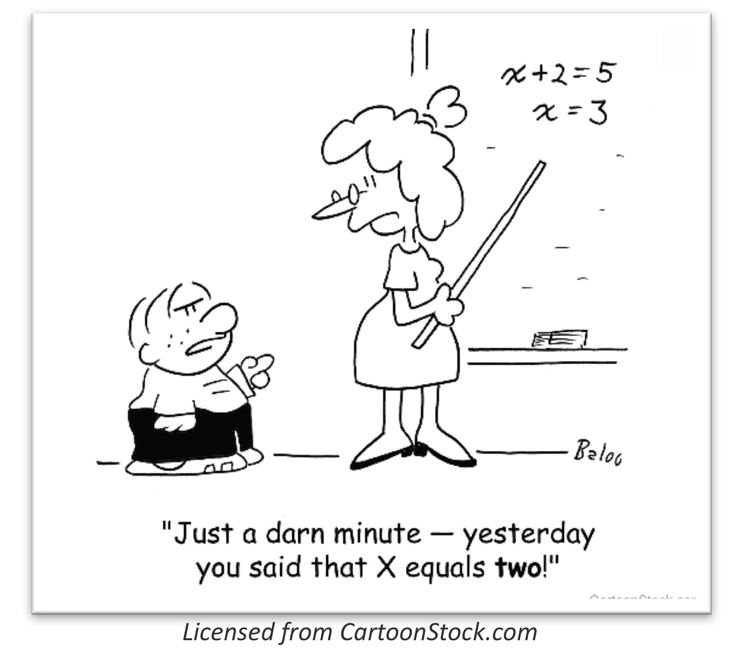
Notes:
Here is an example of student mathematical thinking.

Slide 3

Mathematically significant
pedagogical Opportunities
to build on Student
Thinking
Notes:
Cut or Keep?

Slide 4
Mathematical
Opportunities
in Student
Thinking
Notes:
So, a MOST is a…
Try saying that ten times fast! In the effort to communicate more effectively, we came up with this alternative: Mathematical Opportunities in Student Thinking. It doesn’t convey quite as much information, but it sure is a lot easier to say and remember.

Slide 5
Notes:
Here is an example of student mathematical thinking.

Slide 6
MOSTs are opportunities…
…for the teacher to make student mathematical thinking an object of consideration for the class in order to engage the class in making sense of that thinking to better understand an important mathematical idea.
…to build on student thinking.
Notes:
We feel that [read whole slide]
Our word for this, at the moment, is “building” and we feel that this definition reflects the most productive use a teacher can make of MOSTs.

Slide 7
The teaching practice of building (on MOSTs)
Making student thinking (of a MOST) an object of consideration for the class
in order to engage the class in making sense of that thinking
to better understand an important mathematical idea.
0 Elicit: Invite/allow students to share their mathematical thinking
.5 Recognize: (Recognize a MOST)
1 Make Precise: Make the object to be considered clear
2 Grapple Toss: Turn the object of consideration over to the students with parameters that put them in a sense-making situation
3 Orchestrate: Engage the class in collaborative sense making of the object of consideration that includes a whole-class discussion of that object
4 Make Explicit: Facilitate the extraction and articulation of the mathematical point of the object that was considered

Slide 8
Studying Building (Methodology)
Create instantiations of building and then unpack them
Create
13 Teacher-Researchers (from around the country)
Surfaced predictable MOSTs
Tried to build on them
Video recorded the attempts
Reflected on the attempts
Unpack
What are the teachers doing that seems related to a given subpractice?
Which actions seem particularly productive or potentially unproductive?
When unproductive, what could have been done differently?
Notes:
Next we will illustrate the practice and share insights into important aspects of the subpractices that have emerged through this unpacking.
Be thinking about how we might help teachers to develop skills related to these subpractices.
Add the principles slide?

Slide 9
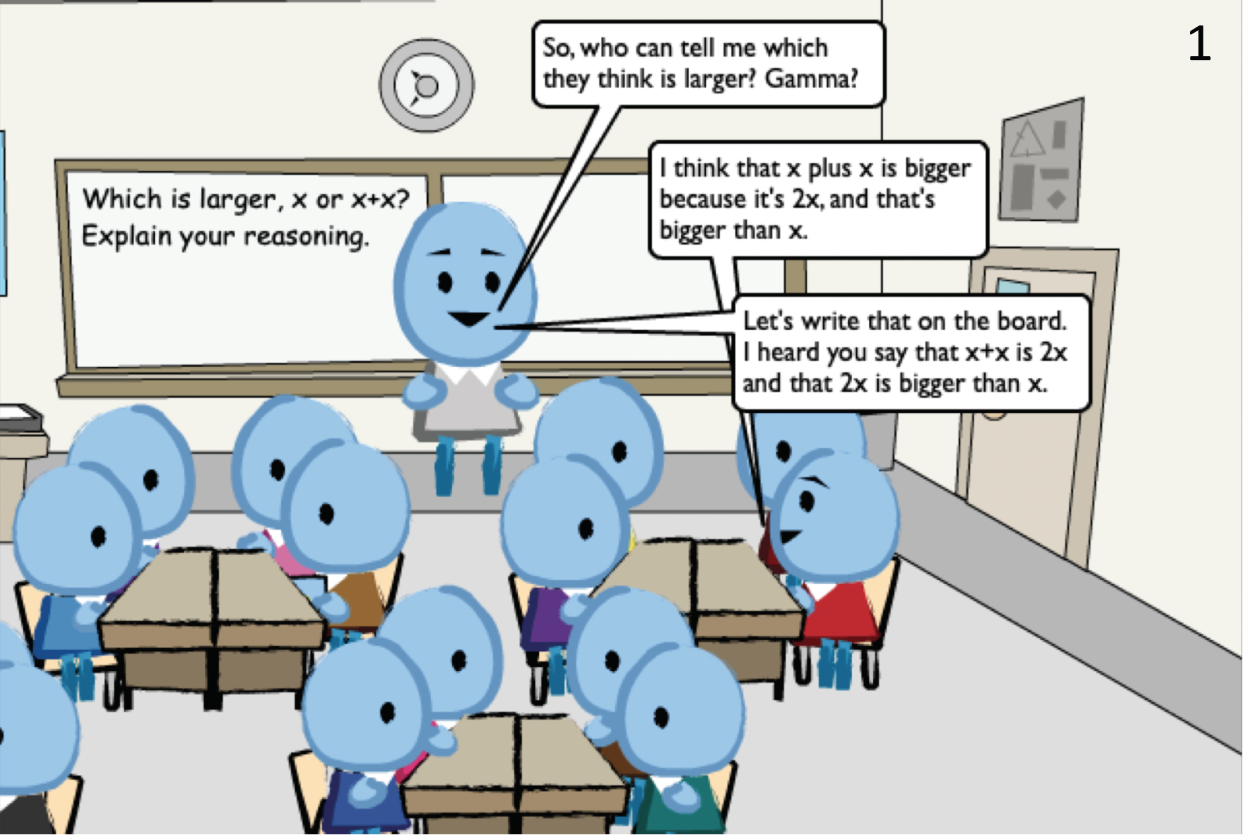

Example
Elicit
Make Precise
Clarify the instance of student thinking
Clarify for you but …
Clarify primarily for the students in the class - take the class along with you
Establish the object: Establish the clarified instance of student thinking as the object the class members will discuss
Create a public record
Scenarios created with LessonSketch © The Regents of the University of Michigan (lessonsketch.org)
Recognize MOST
Make Precise
Mathematically Significant Idea
All possible values within a domain must be considered to determine relative values of variable expressions.
Notes:
Other possible points: repeating

Slide 10
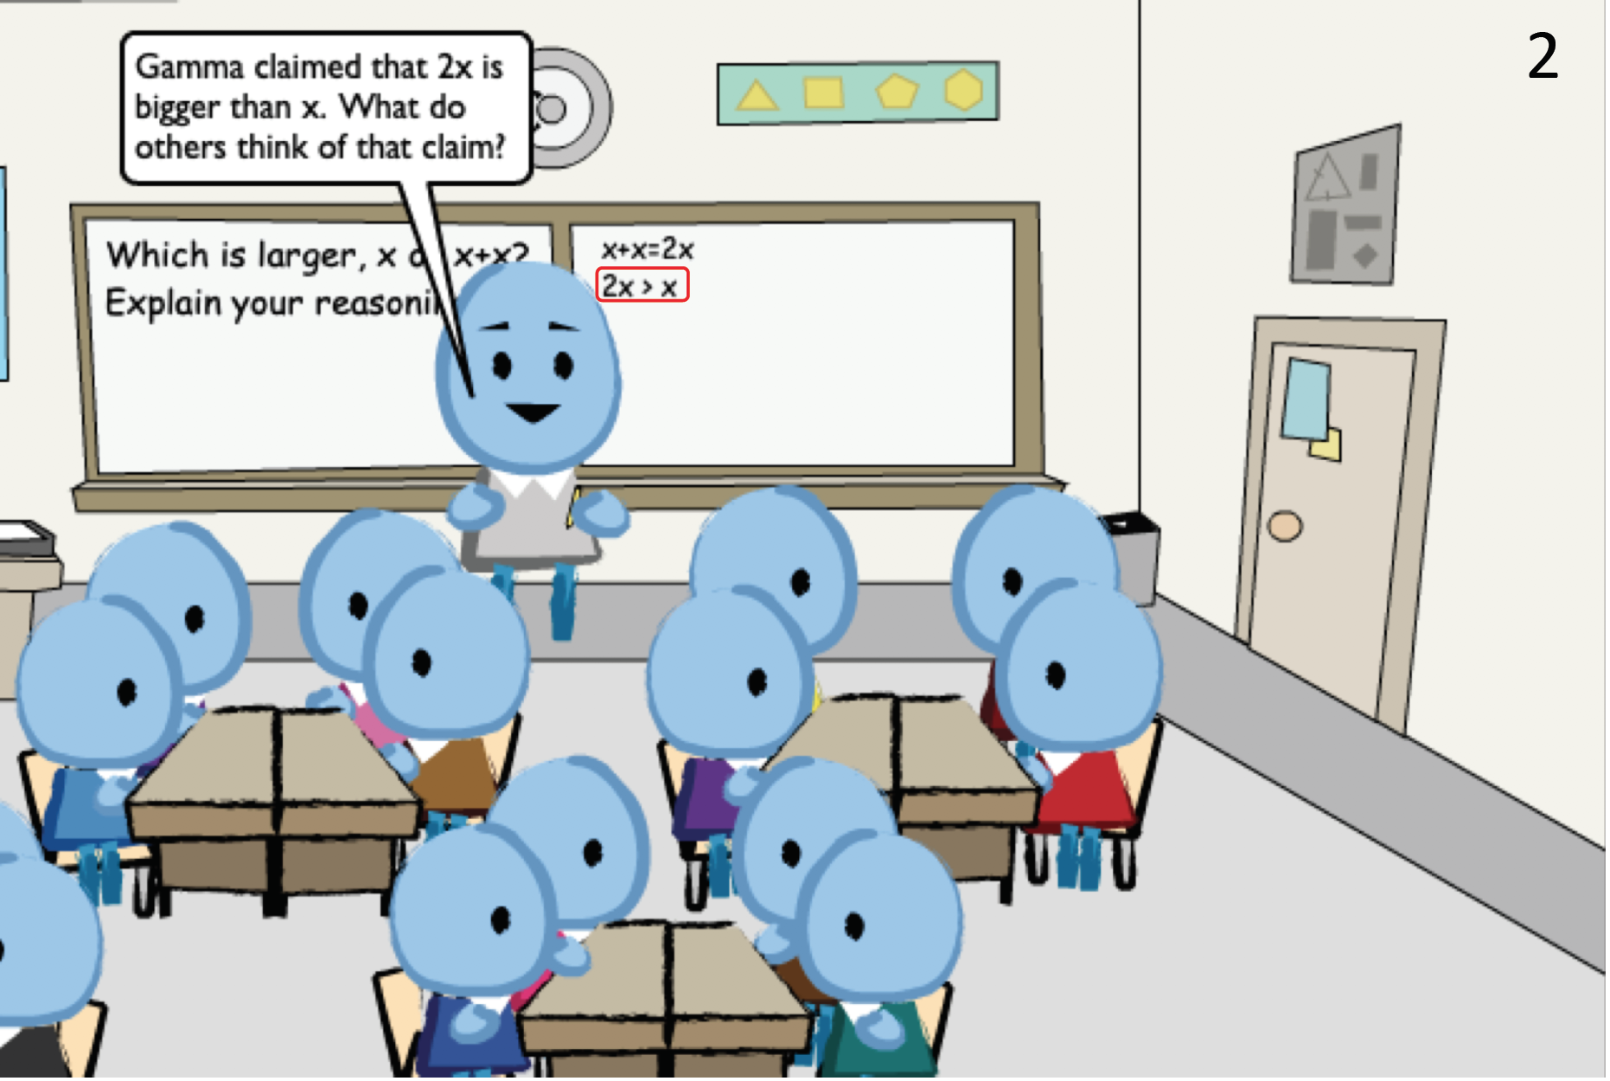
Example
Make Precise
Grapple Toss
Object: What is being tossed?
Action: How will the students engage with the object?
General
What do you think about this [claim, solution, strategy]?
Do you agree or disagree with this [claim, solution, strategy]?
Specific
Will this strategy work in other situations?
How would you justify this claim?
Why does this strategy give us an incorrect solution?
Single clear action is best
Goal is to maximize the likelihood that students engage with the object rather than merely share their own solution or strategy
Make Precise
Establish the object: Establish the clarified instance of student thinking as the object the class members will discuss
Name the object (Gamma’s Claim)
Establish what will we talk about. Will we talk about
what was said?
what was written?
a portion of what was said or written (reasoning vs solution)?
all of the above?
Scenarios created with LessonSketch © The Regents of the University of Michigan (lessonsketch.org)
Grapple Toss
Notes:
Make Precise box comes up first
Grapple Toss box comes up second (hides the first one right now)

Slide 11
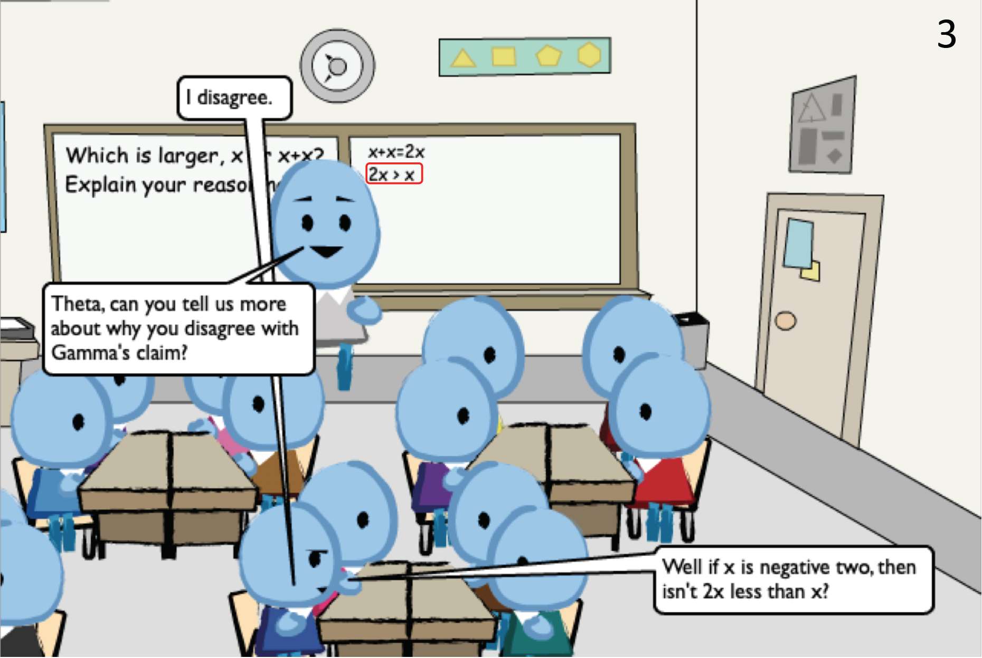
Example
Scenarios created with LessonSketch © The Regents of the University of Michigan (lessonsketch.org)
Orchestrate
Orchestrate
Keep the focus on the MOST
Don’t collect new solutions or strategies
Beware of chaining ideas together and losing focus

Slide 12
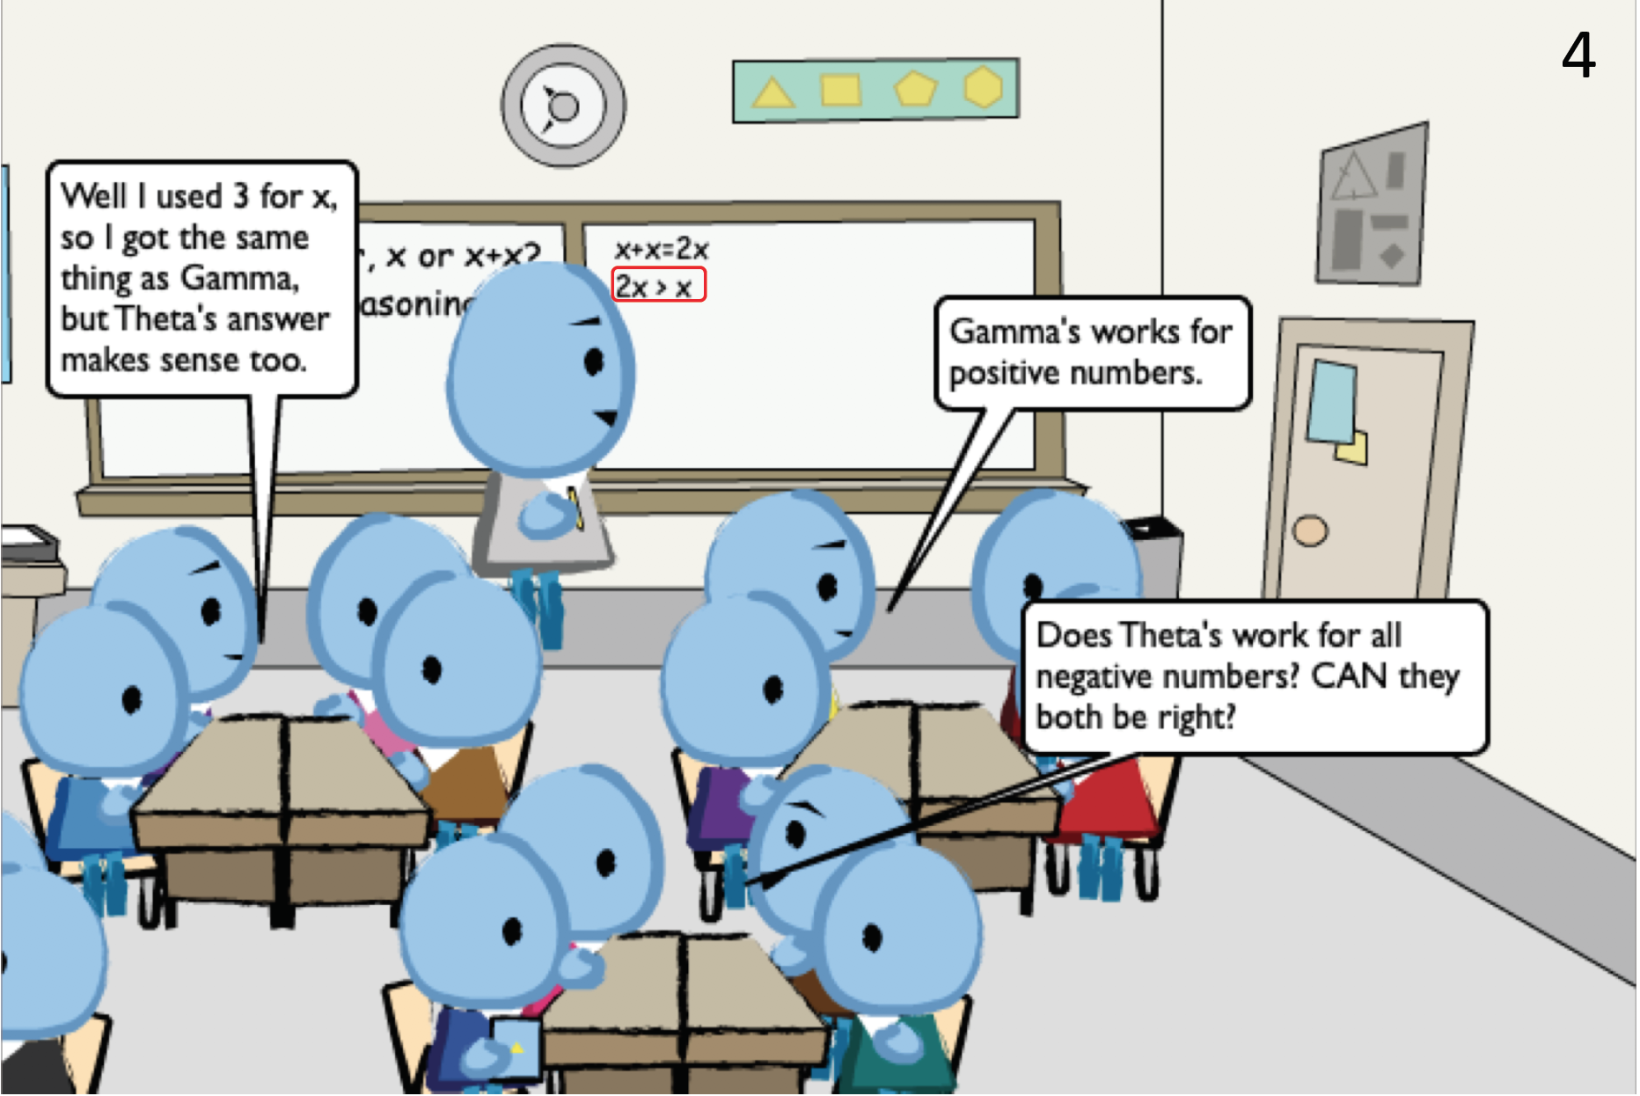
Example
Orchestrate
Scenarios created with LessonSketch © The Regents of the University of Michigan (lessonsketch.org)
Orchestrate
Keep the focus on the MOST
Don’t collect new solutions or strategies
Beware of chaining ideas together and losing focus
Refocus when needed
Connect current thinking back to original MOST

Slide 13
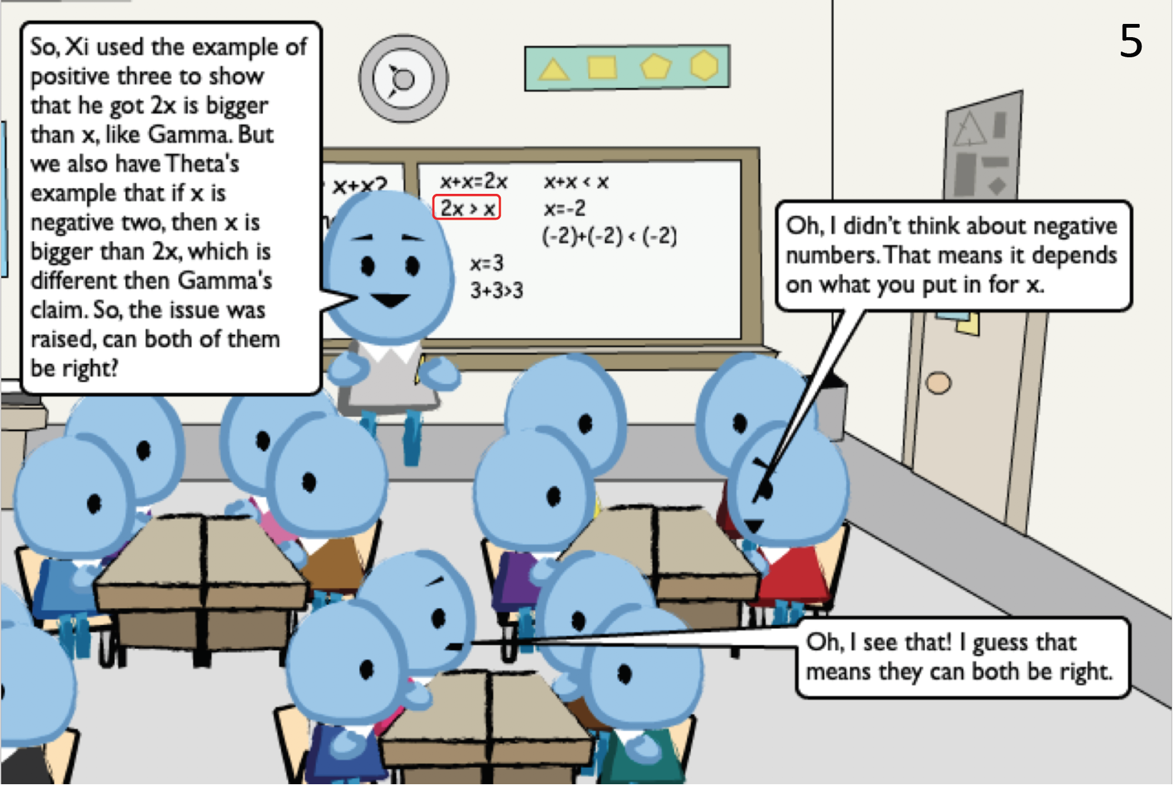
Example
Orchestrate
Scenarios created with LessonSketch © The Regents of the University of Michigan (lessonsketch.org)
Orchestrate
Connect current thinking back to the original MOST
Complex: Synthesize, make precise, toss again

Slide 14
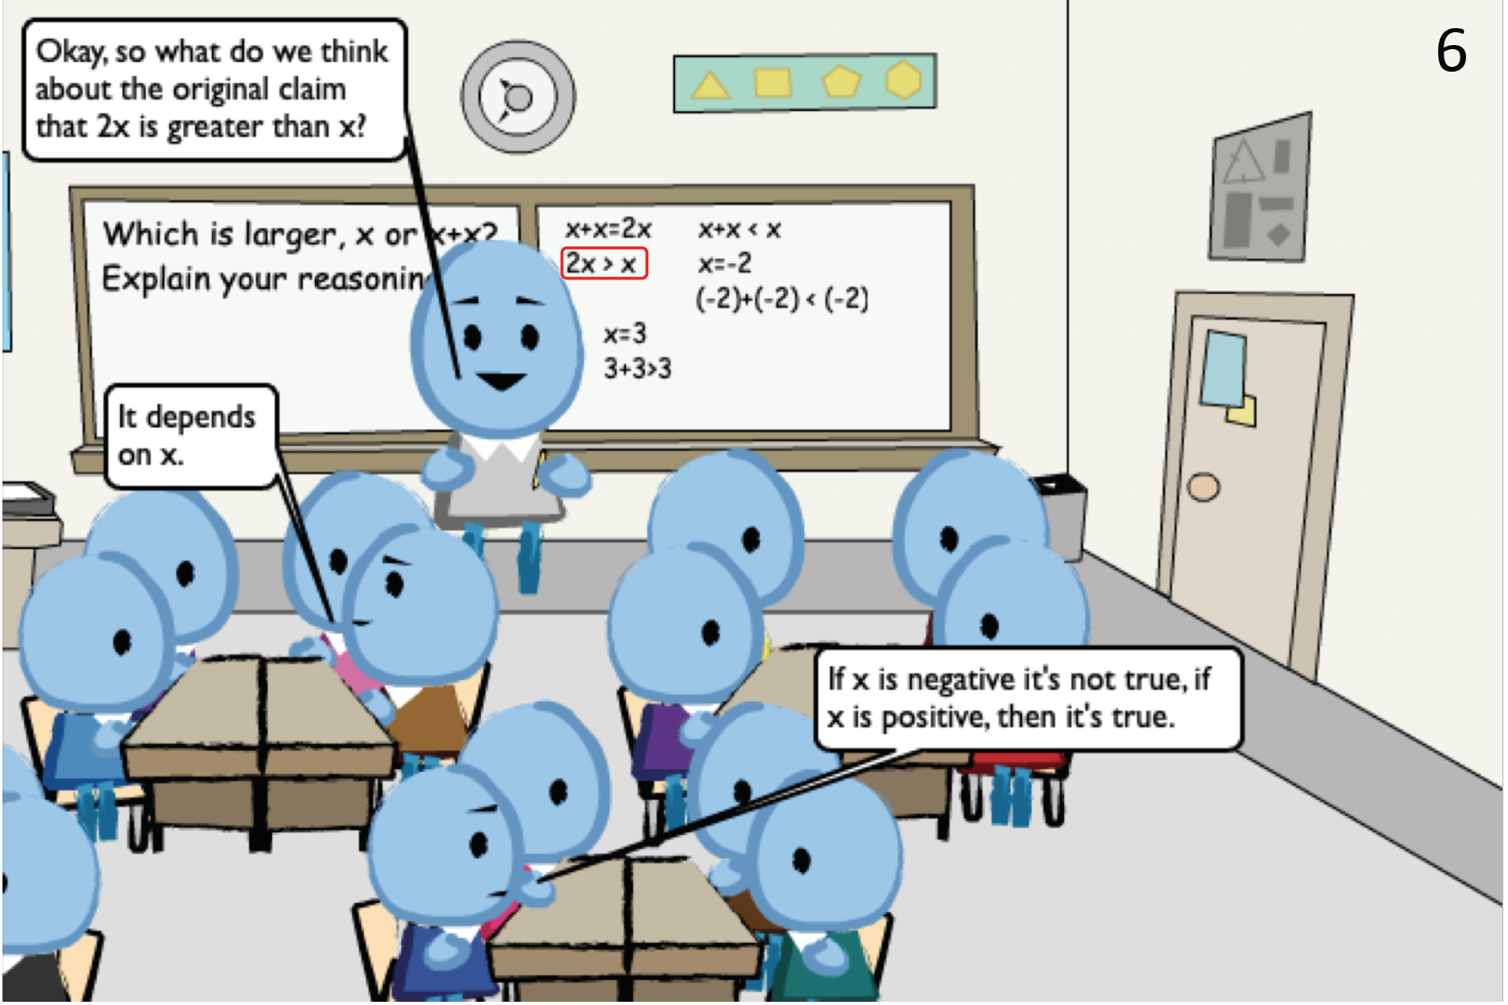
Example
Scenarios created with LessonSketch © The Regents of the University of Michigan (lessonsketch.org)
Orchestrate
Make Explicit
Mathematically Significant Idea
All possible values within a domain must be considered to determine relative values of variable expressions.
Orchestrate
Check in with respect to making sense of the MOST
Are students ready to make explicit?

Slide 15
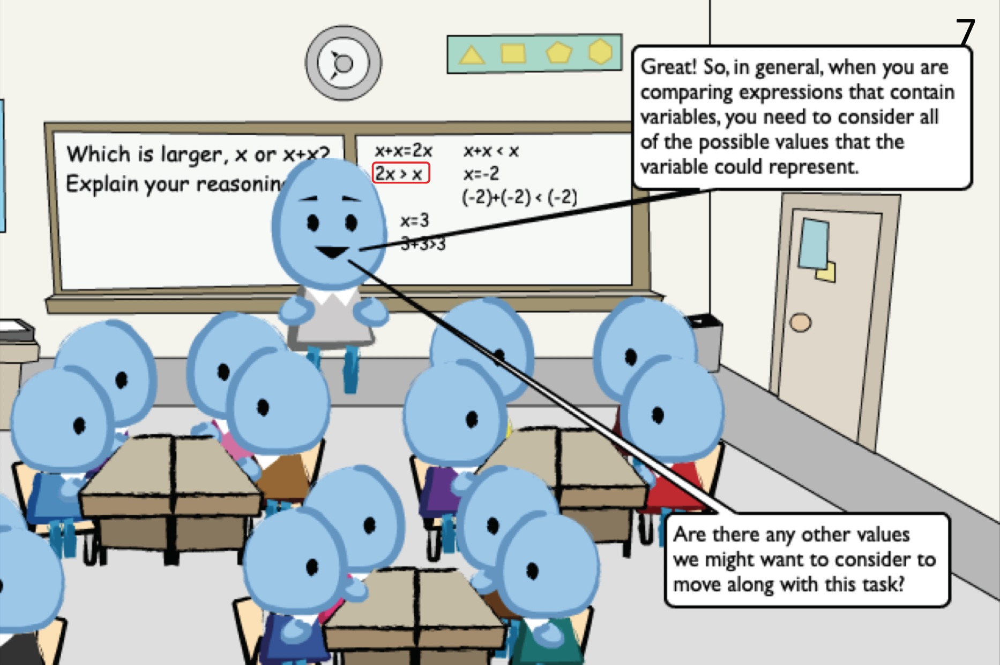
Example
Make Explicit
Scenarios created with LessonSketch © The Regents of the University of Michigan (lessonsketch.org)
Make Explicit
Goal is to abstract the mathematics that underlies the MOST
Resolve the MOST
different than resolving the overall task
Move On

Slide 16
The teaching practice of building (on MOSTs)
Making student thinking (of a MOST) an object of consideration for the class
in order to engage the class in making sense of that thinking
to better understand an important mathematical idea.
0 Elicit: Invite/allow students to share their mathematical thinking
.5 Recognize: (Recognize a MOST)
1 Make Precise: Make the object to be considered clear
2 Grapple Toss: Turn the object of consideration over to the students with parameters that put them in a sense-making situation
3 Orchestrate: Engage the class in collaborative sense making of the object of consideration that includes a whole-class discussion of that object
4 Make Explicit: Facilitate the extraction and articulation of the mathematical point of the object that was considered
Notes:
Possibly print and hand out and/or post to conference website

Slide 17
Discussion
Make Precise
Grapple Toss
Orchestrate
Make Explicit
To what extent do these conceptualizations of our Building subpractices resonate with your experience?
How do you see these conceptualizations as being useful in your practice as a mathematics teacher educator?
What is the value of unpacking mathematics teaching practices to this level of detail?
How might we develop teachers’ skills related to the nuances of these subpractices?

Slide 18
Contact Information
BuildingOnMOSTs.org
THANK YOU!

